Slide 1
Working with Dates and Merge Example

Slide 2
We are interested in merging our customer information with sales
Customer Data:
Sales Data:
What do you notice about the dates in the customer data?
CustomerID | FirstName | LastName | Email | DOB | Phone
1 | John | Smith | John.Smith@yahoo.com | 2/4/1968 | 626 222-2222
2 | Steven | Goldfish | goldfish@fishhere.net | 4/4/1974 | 323 455-4545
3 | Paula | Brown | pb@herowndomain.org | 5/24/1978 | 416 323-3232
4 | James | Smith | jim@supergig.co.uk | 20/10/1980 | 416 323-8888
6 | Mike | Jones | mike@supergig.co.uk | 25/2/1966 | 333-253-9843
CustomerID | Date | SaleAmount
2 | 5/6/2004 | $532.00
1 | 5/7/2004 | $67.98
3 | 5/7/2004 | $334.21
3 | 5/13/2004 | $100.00
4 | 5/22/2004 | $425.88
5 | 1/22/2004 | $169.25

Slide 3
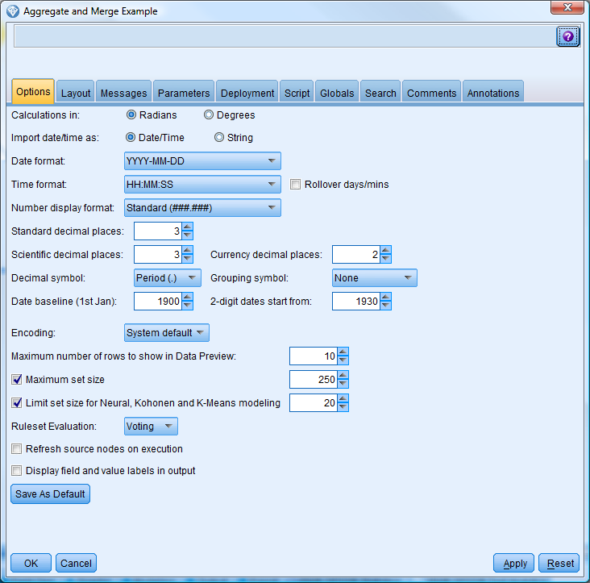
Set the date settings in the Stream Properties under the Tools Menu
Import date/time as:
If string, strings that have the same format as the Date Format will be date type when read by modeler source node and displayed in the Date Format-specified layout. Same for times also.
If Date/Time, the Date Format and Time Format field shows how the dates will be displayed in Modeler
Dates and times can be tricky. Often you will have to play with the settings here or go to the source to correct data to get dates with different formats/ambiguity/errors to be read correctly into Modeler. In this case we corrected dates in the source.

Slide 4
Types of Key Merge in Modeler
Include only matching records (inner join). Select to merge only complete records.
Include matching and non-matching records (full outer join). Select to perform a "full outer join." This means that if values for the key field are not present in all input tables, the incomplete records are still retained. The undefined value ($null$) is added to the key field and included in the output record.
Include matching and selected non-matching records (partial outer join). Select to perform a "partial outer join" of the tables you select in a subdialog box. Click Select to specify tables for which incomplete records will be retained in the merge.
Include records in the first dataset not matching any others (anti-join). Select to perform a type of "anti-join," where only nonmatching records from the first dataset are passed downstream. You can specify the order of input datasets using arrows on the Inputs tab. This type of join does not include complete records in the output dataset. See the topic Types of Joins for more information.

Slide 5
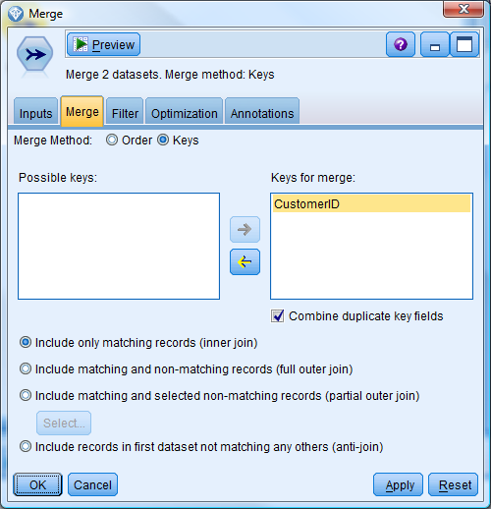
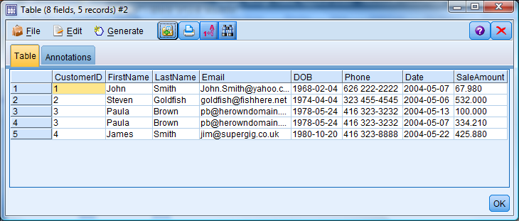
Example Result of Include only matching records (inner join)

Slide 6
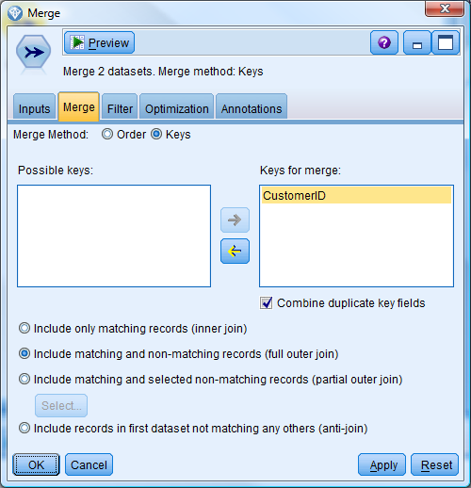
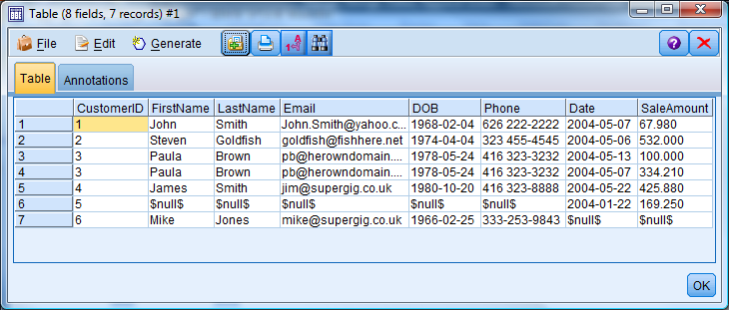
Include matching and non-matching records (full outer join). Example

Slide 7
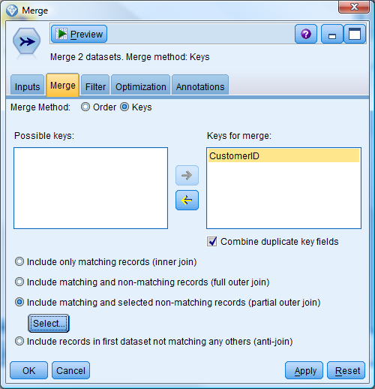
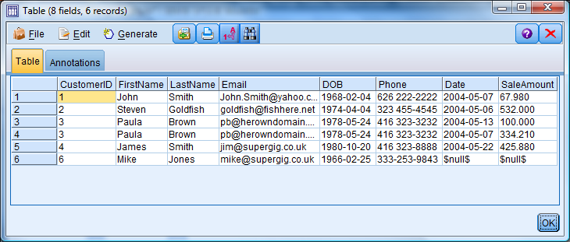
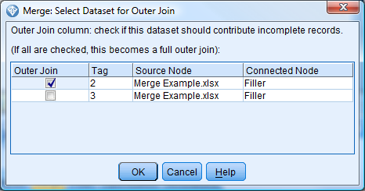
Include matching and selected non-matching records (partial outer join) Example

Slide 8
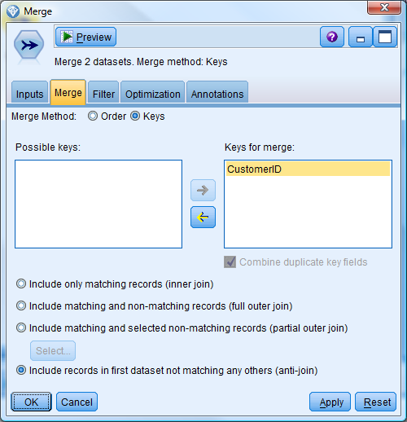
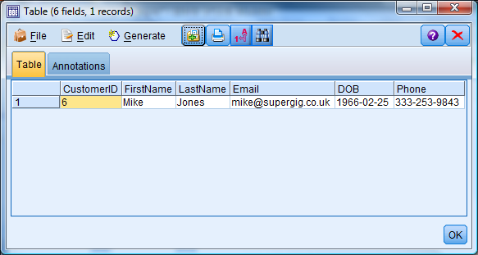
Include records in the first dataset not matching any others (anti-join) Example
Note: First dataset is the first dataset listed in the Input tab

